Slide 1
Where to open a restaurant in Toronto?
By Sebastian Wodjereck

Slide 2
Background
Toronto
2.7M inhabitants (6.4M in the Greater Toronto Area)
97 neighborhoods
Each neighborhood having its own identity, different population, different income, etc.
The problem:
What is the best neighborhood to open a restaurant?

Slide 3
Data Sources
Toronto’s neighborhoods based on postal codes as per Wikipedia (https://en.wikipedia.org/wiki/List_of_postal_codes_of_Canada:_M).
Geospatial data for each neighborhood, i.e. their latitude and longitude value for each postal code (http://cocl.us/Geospatial_data)
Population data for each of Toronto’s neighborhoods based on postal codes, based on the 2016 census of Canada (Source: Statistics Canada. 2017. Population and Dwelling Count Highlight Tables. 2016 Census).
Data about restaurants in each neighborhood (number of restaurants and type of cuisine) taken from the Foursquare API (https://developer.foursquare.com/developer/).

Slide 4
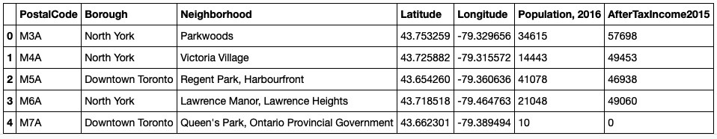
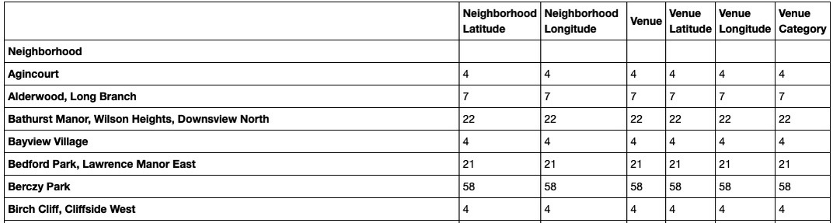
Working with the data…
Combining data on neighborhood‘s population and income with venue information from Foursquare:

Slide 5
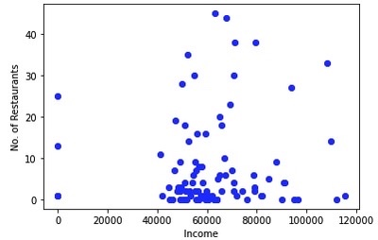
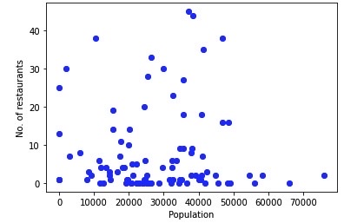
Data visualization
There is no correlation between Income and the number of restaurants in a given neighborhood:
There also is no correlation between Population and the number of restaurants in a given neighborhood:

Slide 6
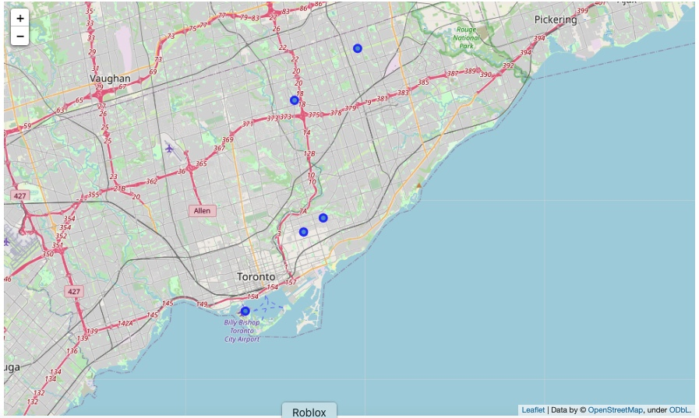
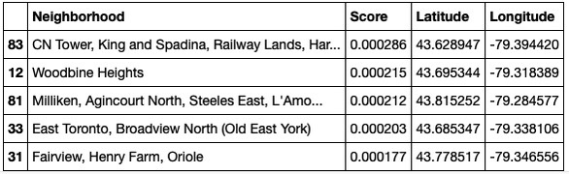
Results
Input:
Weight of the income
Weight of population
Restaurant density (based on means of occurrence)
Output:

Slide 7
Conclusion
Data analysis can help find a solution to a problem that at first glance seems impossible to solve.
Decision-making based on facts and figures
Possibility for visuals (e.g. if one decides to live in a certain area and doesn’t want to commute very far, it is easy to spot on the map).

